Slide 1
PX4 and ROS 2 – The Brain and Nervous System of Modern Drones”

Slide 2
Agenda
Introduction to PX4 and ROS
Industrial Analogy: How PX4 and ROS 2 Work Together
PX4 – Deeper Insight
ROS 2 – Industrial View
QGroundControl + PX4 + Gazebo Simulation Demo
Camera Control and MAVLink Inspector Highlights

Slide 3
From Remote-Controlled to Self-Aware: Evolution of Drone Autonomy
Let’s explore how PX4 (the pilot) and ROS 2 (the AI brain) power this revolution.
🎯 Learning Goals :
Understand how modern drones think and act autonomously.
Explore PX4 autopilot architecture & its industrial ecosystem.
Learn how ROS 2 enables AI and autonomy in real UAV platforms.

Slide 4
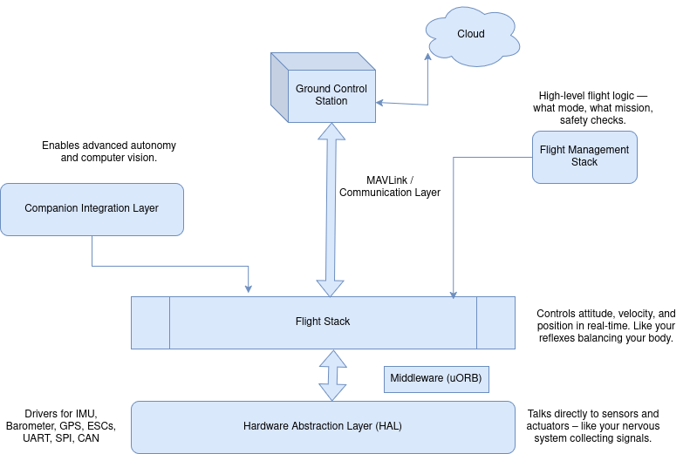
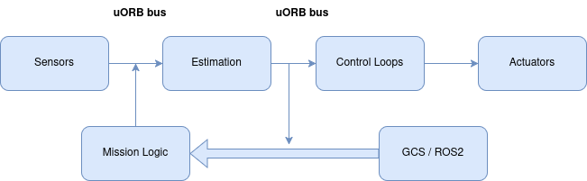
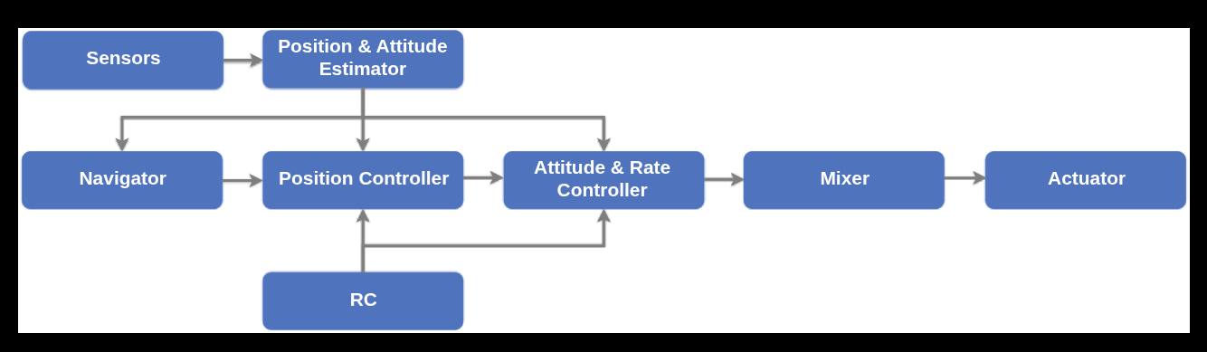
PX4 Autopilot Architecture – The Pilot Inside the Drone
Key Insight

Slide 5
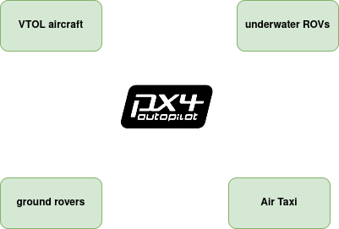
PX4 Beyond the Basics – Where It Meets Industry
Sector | PX4 Integration Example
Logistics | Autonomous delivery drones with ROS2 perception.
Defense | Swarm coordination using MAVSDK + PX4.
Agriculture | PX4 + ROS2 for multi-drone spraying systems.
Inspection | PX4 controlling flight, ROS2 handling vision-based inspection.

Slide 6
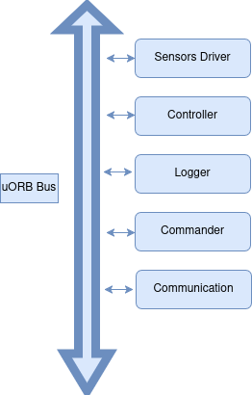
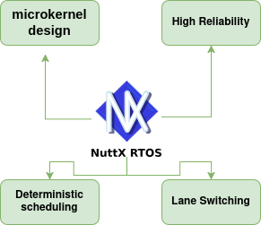
PX4 Microkernel – The Real-Time Brain Inside
PX4 runs on NuttX RTOS, a real-time operating system.
Uses microkernel design → each PX4 module (e.g., sensors, controller, logger) runs as an independent task.
If one task crashes, others continue — ensures high reliability.
Deterministic scheduling: every loop (like attitude control) executes with predictable timing.

Slide 7
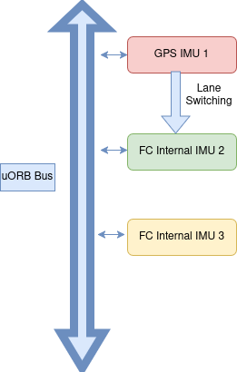
Industrial Analogy – How PX4 Keeps Flying When One Sensor Fails using Nuttx OS
Lane Switching (IMU1) GPS and (IMU2) FC connected sensor.
The (NuttX scheduler) constantly monitors both. If IMU1 gives wrong reading or fails quality checks, the scheduler instantly diverts IMU2 — without stopping the entire process
In PX4, every control lane has a backup
NuttX just knows when to switch.

Slide 8
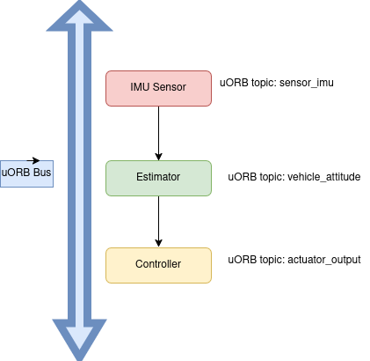
uORB – How PX4 Modules Talk to Each Other
uORB = micro message bus inside PX4.
Implements a Publisher-Subscriber pattern → one module publishes data, others subscribe.
Sensor publishes IMU data. Estimator subscribes to IMU, publishes attitude. Controller subscribes to attitude, outputs actuator commands.

Slide 9
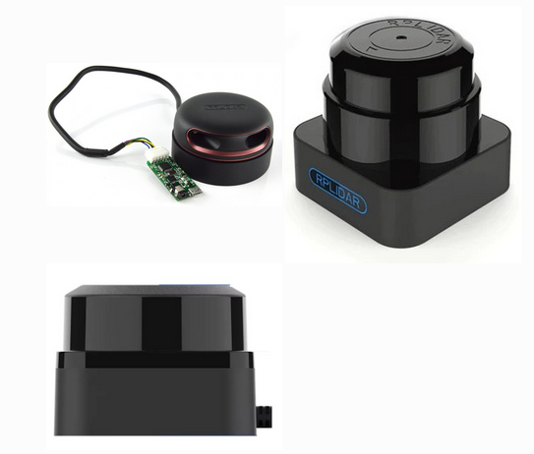
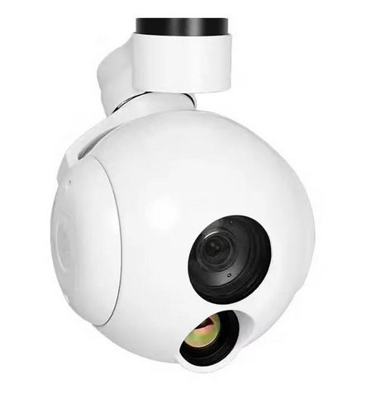
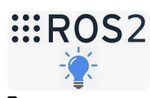
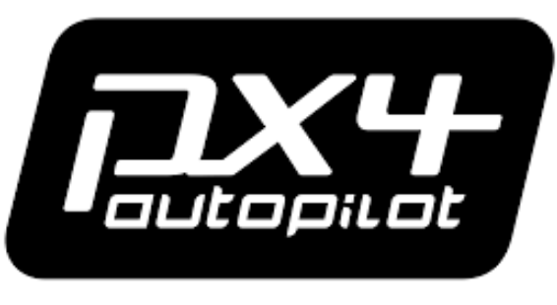

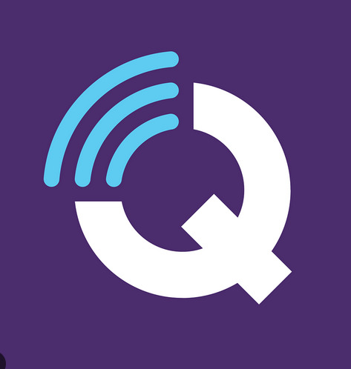
How PX4 and ROS 2 Work Together
“In industry, every intelligent system has a balance between control and decision-making — in drones, PX4 controls, ROS 2 decides, and MAVLink connects.”
Brain
Intelligent Controls

Slide 10
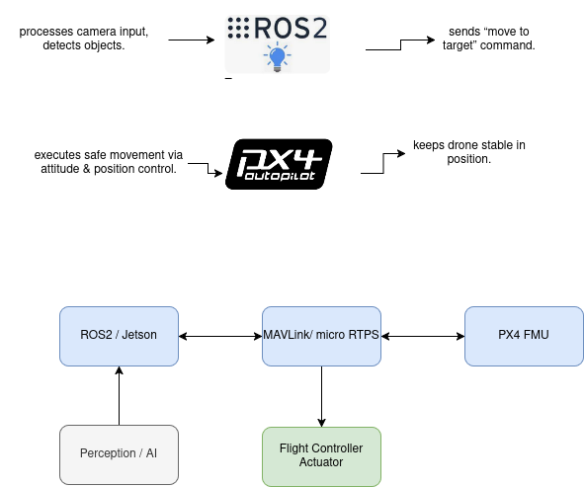
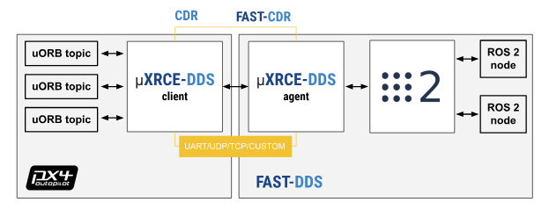
PX4 Meets ROS 2 – The Autonomy Connection
PX4 manages low-level flight control (stabilization, safety).
Companion computer (Jetson, Raspberry Pi, etc.) runs ROS 2 for high-level autonomy.
Communication via MAVLink, MAVROS, or microRTPS bridge.
PX4 → executes
ROS 2 → perceives & plans.

Slide 11

From Research Labs to Industry Floors
ROS (Lab) 🧪 → ROS 2 (Factory) 🏭 → ROS 2 + PX4 (Air) 🚁
ROS (Lab)
ROS 2 (Factory) 🏭
ROS 2 + PX4 (Air) 🚁
Analogy:
“ROS was like a college project — creative but fragile. ROS 2 is like a certified industrial control system — modular, secure, and real-time.”

Slide 12
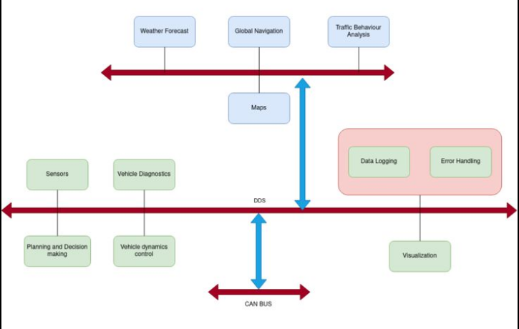
– The Operating System for Robots
🧩 Why It’s Industrial Grade
DDS = same middleware used in aerospace, defense, and automotive.
QoS allows deterministic behavior (e.g., high-rate IMU vs slow planner).
Modular → each node can be distributed across multiple computers.
High Performance ⚡
Data Centric Design 🧩
Discovery Mechanism 🔍
Automated peer discovery — no need for a central master.
Quality of Service (QoS) 🎚️

Slide 13
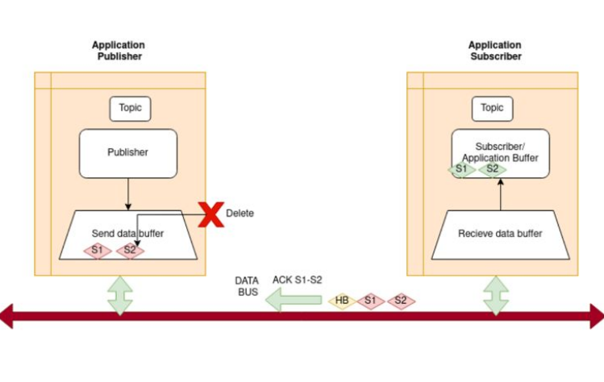
Data Communication In DDS

Slide 14
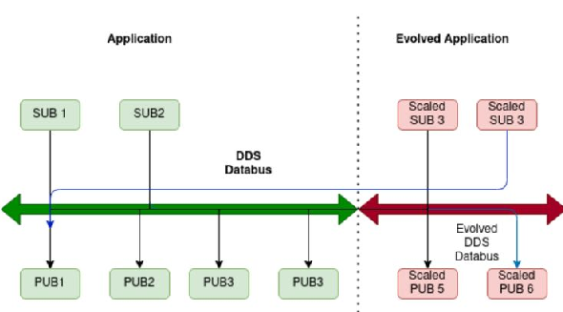
ROS 2 Scalability – From Robots to Fleets

Slide 15
PX4 + Gazebo + QGroundControl
make px4_sitl gazebo_typhoon_h480
Start QGC
Camera Integration
Range Finder
Mavlink Inspector

